Slide 1
ATOM AND MOLECULES

Slide 8
ye wala samja,line ka matlab

Slide 14
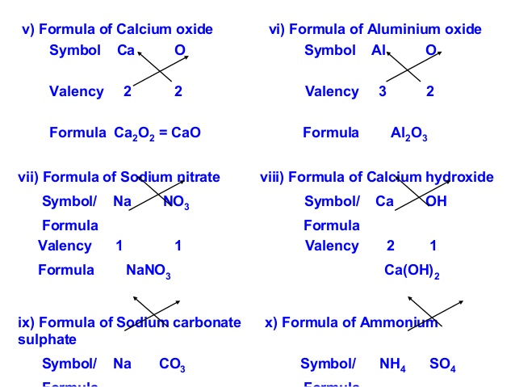

Slide 47
